Slide 1
Quick Test Professional

Slide 2
Mercury Interactive Tool Family…
QuickTest Professional | Automated functional testing of every major enterprise environment, including SAP, Oracle, Siebel, PeopleSoft, .Net, Java, and more
Astra QuickTest | Automated functional testing of HTML, DHTML, JavaScript and ActiveX
Astra LoadTest | Load testing solution that verifies the scalability and performance of Web applications
Astra SiteManager | Web performance tool that identifies broken links, access problems and usage information.
Winrunner | Automated functional testing tool for web & Client server applications
LoadRunner | Performance testing tool for client server and web applications

Slide 3
QTP…Support & Version…
Support for Modern Development Environments, including:
  Over 40 .Net 1.0 and 1.1 Winforms controls
  .Net grids from Microsoft, Infragistics, ComponentOne, and DevExpress
  JDK 1.4.1 and 1.4.2
  Complex MFC controls like ListViews and TreeViews
  Latest releases of SAP, Siebel, Oracle, and PeopleSoft
  Latest terminal emulator releases for IBM Personal Communications, Attachmate Extra, Hummingbird HostExplorer, and NetManage Rhumba.
QTP Version:
  8.2

Slide 4
WinRunner | Both | QuickTest Pro
Custom C/S PowerBuilder Forte Delphi Centura Stingray SmallTalk ERP/CRM Baan PeopleSoft Windows Siebel 5, 6 GUI Clients Oracle GUI Forms | Web-Related Environments IE, Netscape, AOL JDK, Java Foundation Classes, AWT Symantec Visual Café ActiveX Controls ERP/CRM Oracle: Jinitiator, 11i, NCA JD Edwards Web Client Custom Client Server Windows C++/C Visual Basic Operating Systems Win 98, 2000, NT, ME, XP Legacy 3270, 5250 Emulators vt100 | ERP/CRM mySAP Siebel 7.x PeopleSoft 8.x. .NET WinForms WebForms NET controls Web Services XML WSDL UDDI Multimedia RealAudio\Video Flash

Slide 5
QTP…Features…
Recovery Manager to enable true 24/7 testing
Scripted Initialization for rapid test lab configuration
Rapid Object Import to quickly populate the Object Repository
Analog Record/Replay, enabling any client environment to be tested
Improved WinRunner and TestDirector Integration, to better leverage existing testing assets
Unified Reports, enabling composite tests consisting of both WinRunner and QuickTest Professional scripts to be viewed in one interface
Improved Performance: Active Screens load faster, TestDirector integration is 33% faster, and XML checkpoints complete in one tenth the time
Automation API to extend functionality to meet your custom testing needs
Other Features:
XML schema validation; checkpoint timeouts; improved checkpoints for bitmaps, databases, tables, text, and XML; Active Screen authentication; improved text recognition; and improved Expert View support of .Net and Java properties and methods.

Slide 6
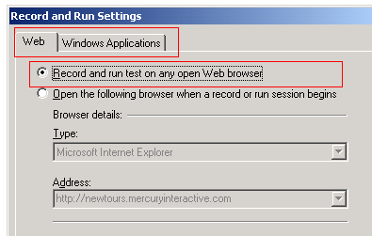
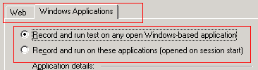
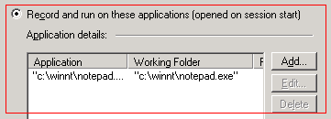
QTP…Record & Run Settings
Record & Run Settings for Web & Windows Applications:
Record: Record the scripts
Run : Execute the scripts
Stop : Stop the execution of scripts

Slide 7
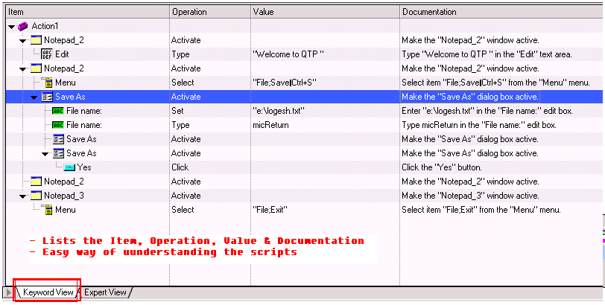
QTP…Keyword View…

Slide 8
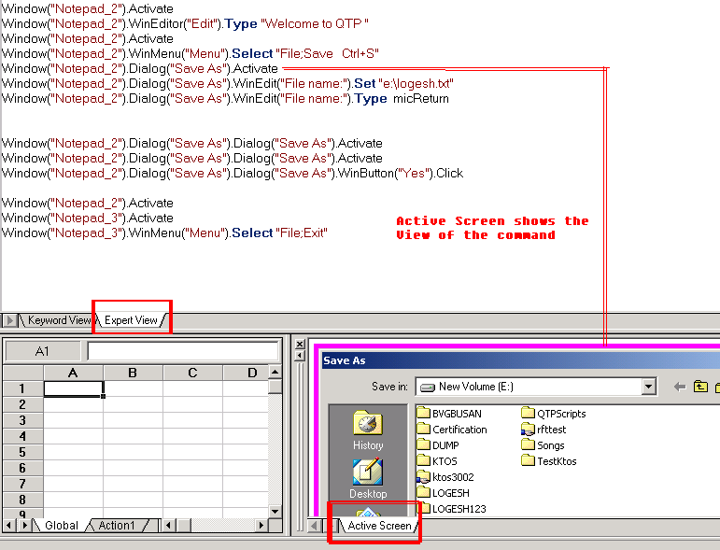
QTP…Expert View & Active Screen…

Slide 9
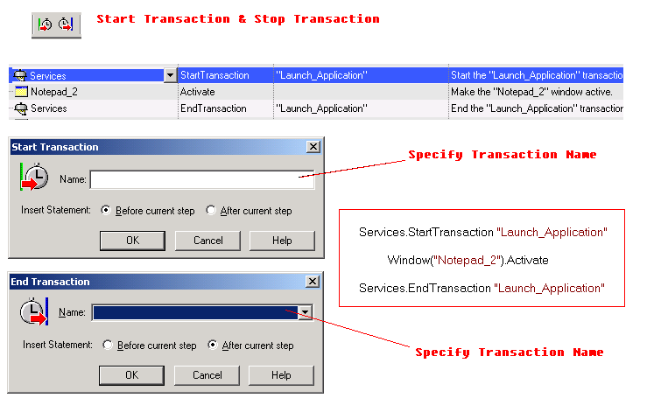
QTP…Start Transaction & Stop Transaction

Slide 10
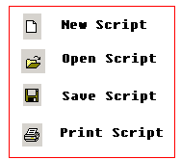
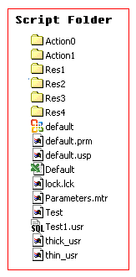
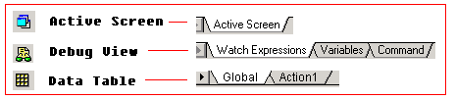
QTP…Tool Bar…

Slide 11
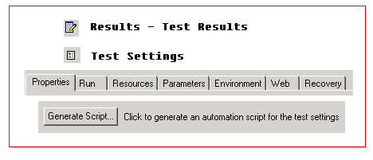
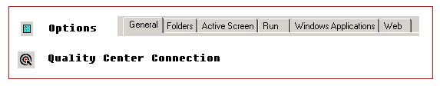
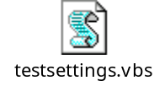

Slide 12
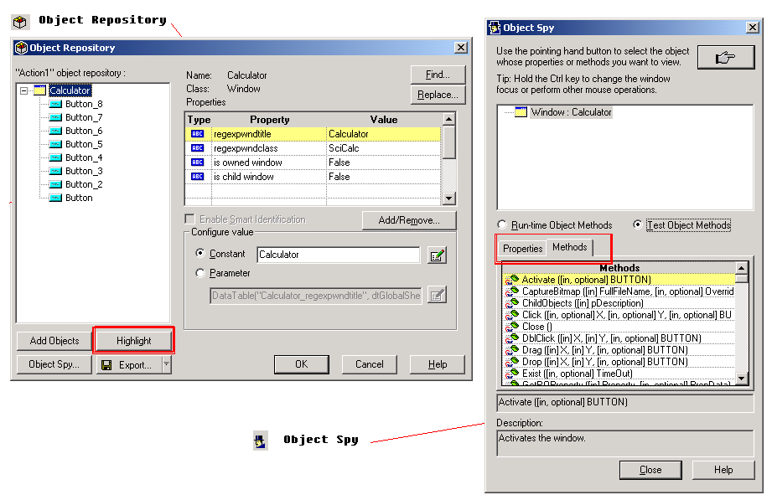
QTP…Object Repository & Object Spy
Object Repository…Lists Objects, Properties & Values
Object Spy…Identify the Object Name, Property & Values

Slide 13
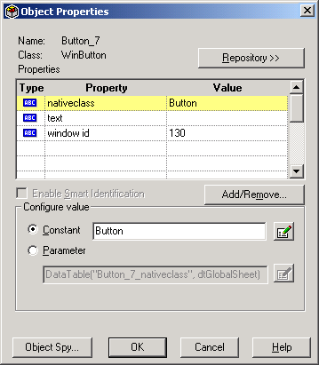
QTP…Object Property
Step > Object properties…

Slide 14
QTP…Checkpoints…
Checkpoint Type | Description | Example of Use
Standard Checkpoint | Checks values of an object’s properties | Check that a radio button is selected.
Text / Text Area Checkpoint | Checks that a text string is displayed in the appropriate place in a Web page or application window | Check whether the expected text string is displayed in the expected location on a Web page or dialog box.
Bitmap Checkpoint | Checks an area of a Web page or application after capturing it as a bitmap | Check that a Web page (or any portion of it) is displayed as expected.
Database Checkpoint | Checks the contents of databases accessed by an application or Web site | Check that the value in a database query is correct.
Accessibility Checkpoint | Identifies areas of a Web site to check for Section 508 compliancy | Check if the images on a Web page include ALT properties, required by the W3C Web Content Accessibility Guidelines.
XML Checkpoint | Checks the data content of XML documents | Note: XML file checkpoints are used to check a specified XML file; XML application checkpoints are used to check an XML document within a Web page.

Slide 15
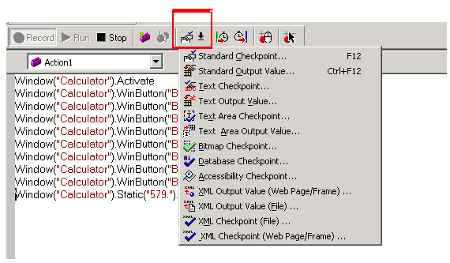
QTP…Checkpoints…

Slide 16
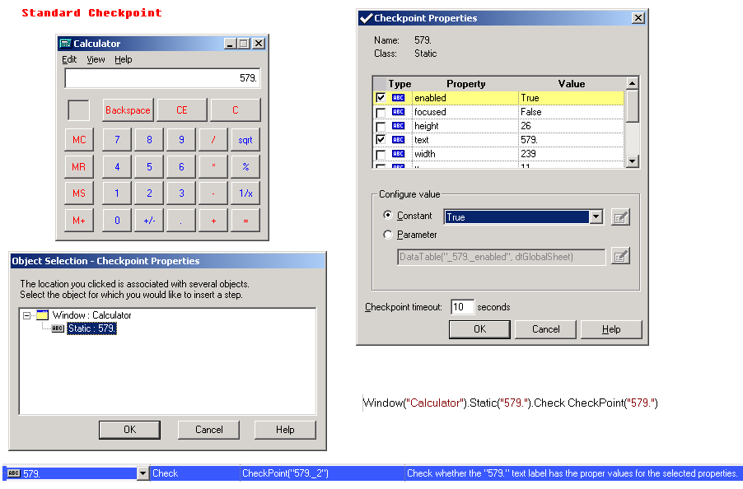
Checks values of an object’s properties

Slide 17
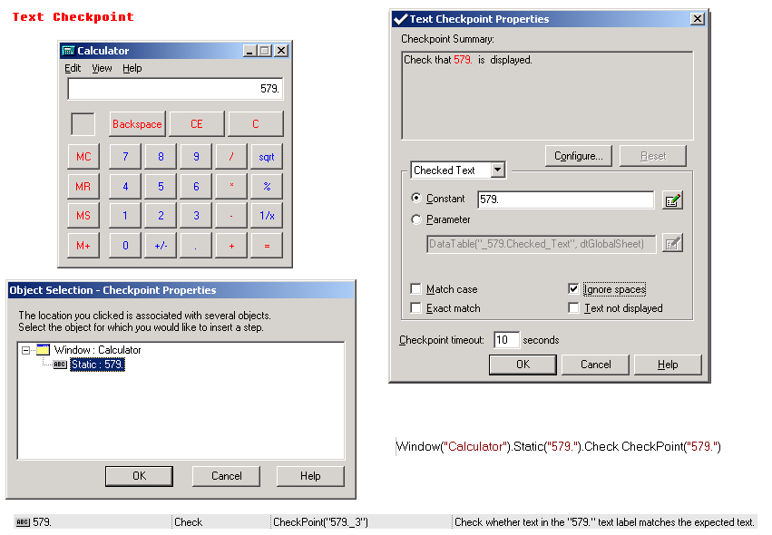
Checks that a text string is displayed in the appropriate place
in a Web page or application window

Slide 18
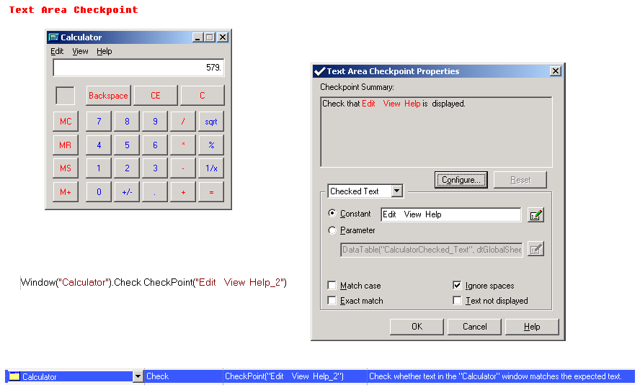
Checks that a text string is displayed in the appropriate place
in a Web page or application window

Slide 19
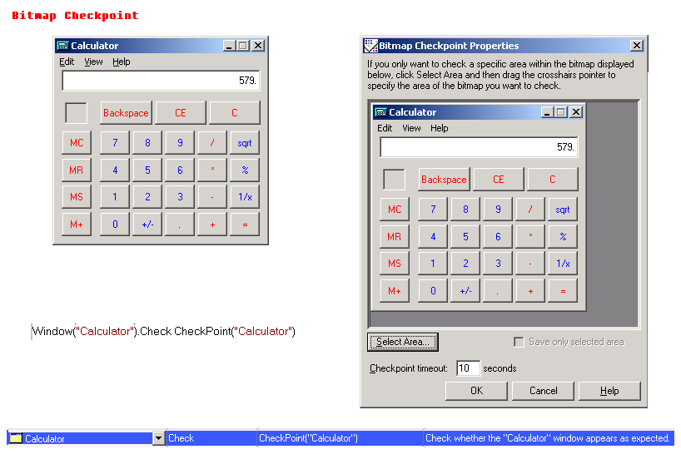
Checks an area of a Web page or application after capturing it as a bitmap

Slide 20
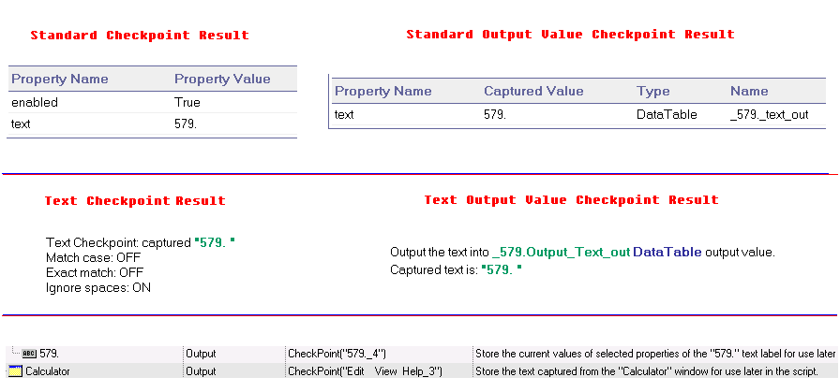
Output Value Checkpoints: Standard, Text & Text Area

Slide 21
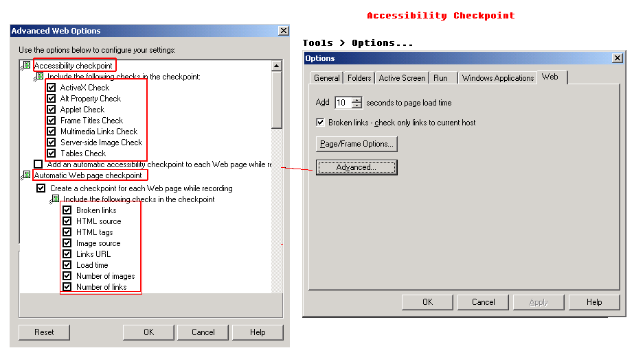

Slide 22
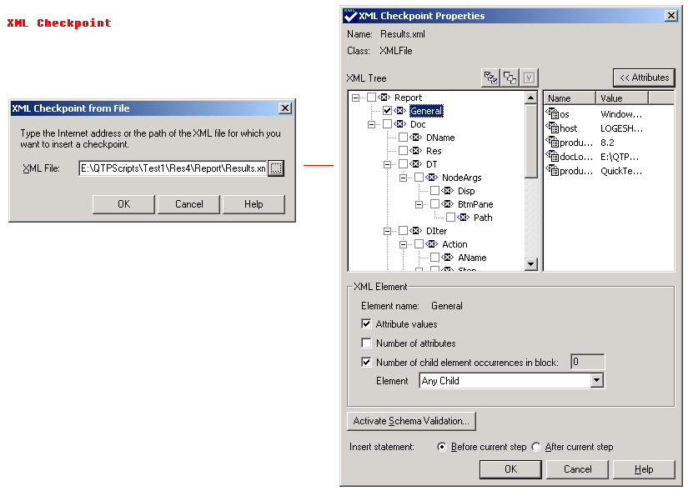
Checks the data content of
XML documents

Slide 23
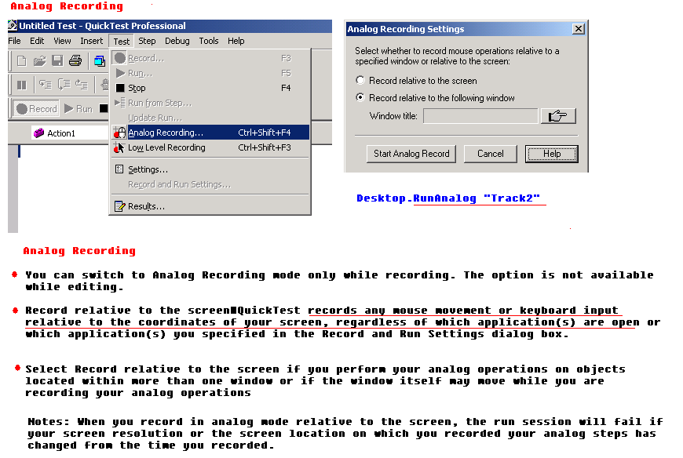
QTP…Recording Modes…

Slide 24
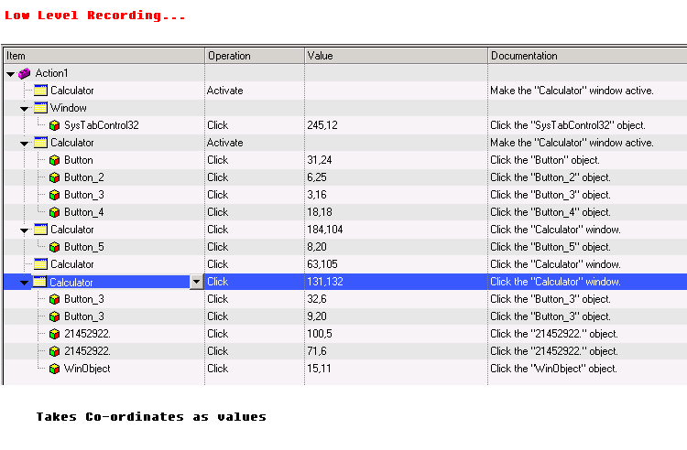

Slide 25
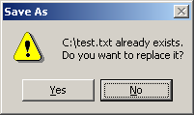
QTP…Recovery Manager
Scenario:
  Launch Notepad.exe
  Type some contents
  Save file name as c:\test.txt
  Exit Notepad
When the script is executed for the first time, it works fine. When the same script is executed second time, we will be getting “File Already Exists” message.
How to Handle this ?
Solution:
Recovery Scenario Manager

Slide 26
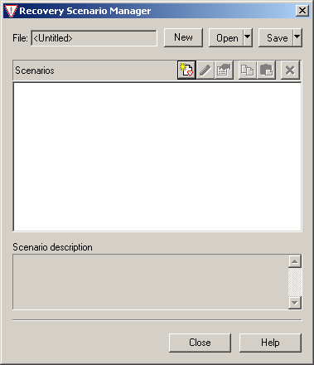
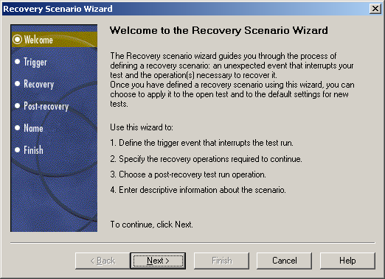
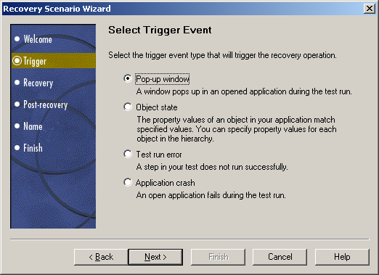
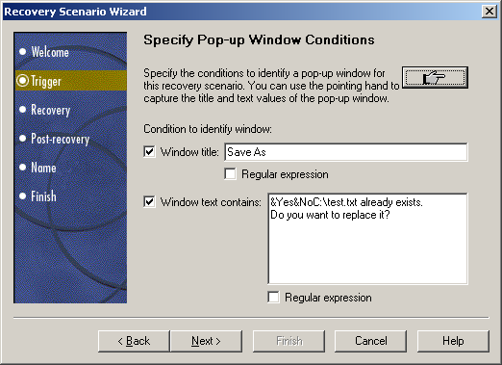
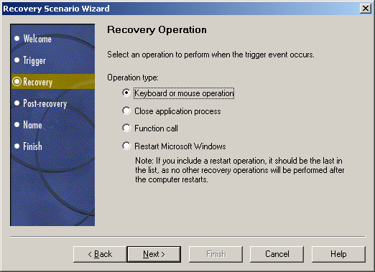
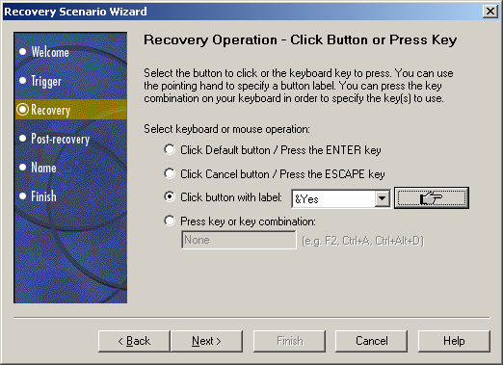
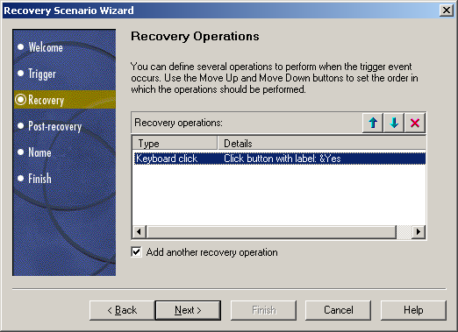
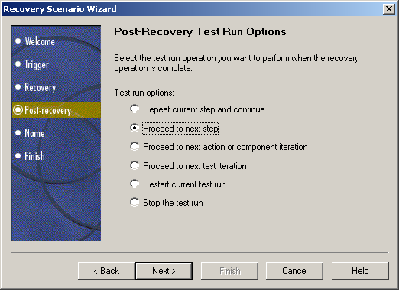
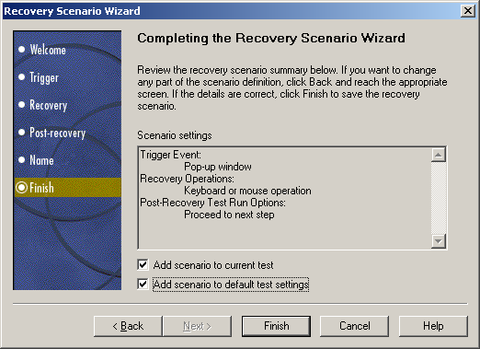

Slide 27
QTP…Object Repository
Object Repository
Object Repository Manager
- Saves as .tsr file
Associate Object Repository
Create script for calculator
Run the script
Open Object Repository
Remove all the objects from the repository
Open Object Repository Manager
Add the Calculator objects to it
Save the object repository – saves as .tsr file
Open the script
Open Associate object repository and call the .tsr file

Slide 28
QTP…Virtual Objects
Virtual Objects > New Virtual Object >
> Virtual Object Manager
Eg) Minesweeper

Slide 29
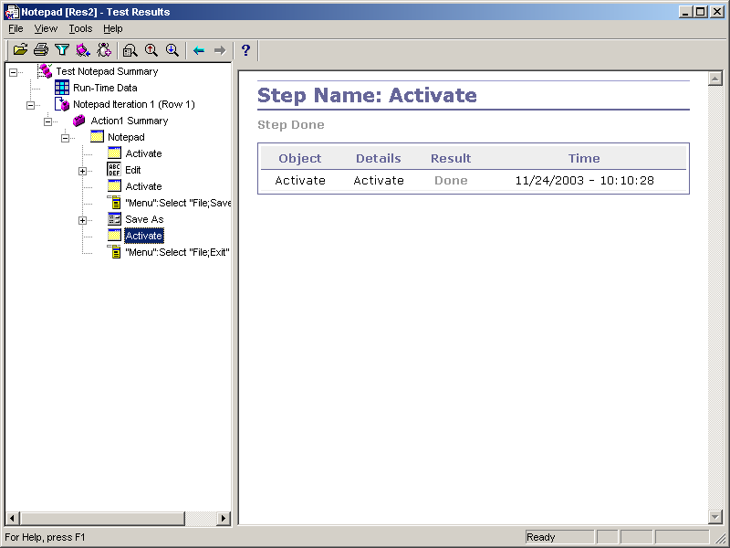
QTP…Results View…

Slide 30
Sample 1:
' Output value checkpoint sample….
‘ Retrieving the value from data table….
XMLFile("Results.xml").Output CheckPoint("Results.xml_3") ' XMLOutput Value checkpoint
Dim val
val = Datatable.Value("os_out",dtGlobalSheet) ' Retrieving the value from data table
val1=Datatable.Value("host_out",dtGlobalSheet) ' Retrieving the value from data table
msgbox val
msgbox val1
Sample 2:
' Reporting value to Test result...
' Standard output checkpoint used for data value..
Dialog("Display Properties").Move 384,30
Dialog("Display Properties").WinTab("SysTabControl32").Select "Screen Saver"
Dialog("Display Properties").WinComboBox("WinComboBox").Output CheckPoint("WinComboBox")
Dialog("Display Properties").WinButton("OK").Click
Dim val
val = Datatable.Value("WinComboBox_text_out",dtGlobalSheet) ' Retrieving the value from data table
If val = "Beziers" Then
Reporter.ReportEvent 0, "Screen Saver Value : "+val, ""
else
Reporter.ReportEvent 1, "Screen Saver Value : "+val, ""
End If

Slide 31
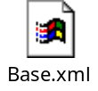
Sample 3:
' Retrieval of an property value from object....
' GetROProperty function is used....
Dialog("Display Properties").Activate
Dim temp
temp = Dialog("Display Properties").WinComboBox("WinComboBox").GetROProperty("text")
msgbox temp
Object SPY & Object Repository
Sample 4:
‘ Setting up Constants in XML file and calling the contant variable in scripts
Environment.LoadFromFile("E:\QTPScripts\base.xml")
'display value of one of the Environment variables from the External file
temp = Environment("AppPath1")
msgbox temp
invokeapplication temp

Slide 32
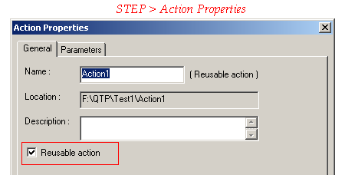
Sample 5:
' Calling script from Action
Select from Menu “Insert” > “Existing Action to Script”
Callscript “ 1”
Callscript “ 2”
Another Way….
Use Batch Utility
Note: Test can contain more than 1 Action
Go to Automation > Run only Current Action [To run only 1 Action]

Slide 33
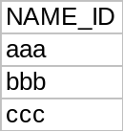
Sample 6:
‘Retrieving data from EXCEL sheet
DataTable.SetCurrentRow("1")
For NAME_ID = 1 to 3
a=DataTable.Value("NAME_ID")
msgbox a
DataTable.SetNextRow
Next
Sample 7:
‘Library Files – c:\libray\sample.vbs
Function Test
msgbox “A”
End Function
‘ In Script
ExecuteFile “c:\library\sample.vbs”
Call Test

